Slide 1
Data Collections and HiQ2

Slide 2
Agenda
What does Highly Qualified mean?
What is HiQ2?
Where is HiQ2?
How to begin using HiQ2.
When does HiQ2 open and close?

Slide 3
What is Highly Qualified?
Must have a bachelor’s degree or better from an accredited institution.
Must hold a valid Georgia teaching certificate.
Must have evidence of subject matter competency:
By academic major OR equivalent semester hours
AND passing score on State approved content assessment
Must have teaching assignment in appropriate fields.

Slide 4
What is “HiQ2”?
HiQ2 is an online educator inventory system...
…to determine if an educator meets the Federal definition of “highly qualified” when placed in a particular teaching assignment
…and to gather data to report to USDOE, to use for AYP, etc.

Slide 5
What is “HiQ2”?
HiQ2 is a database
Updated annually using DOE’s Fall CPI data set
School systems edit HiQ2 beginning in January
Continuously updated from the PSC’s Certification and Testing Information System

Slide 6
What is the relationship between HiQ2 and CPI?
CPI subject and job codes are translated to HiQ subject and job codes.
CPI subject codes show the subject matter and the modality of instruction
CPI job codes show type of educator and grade level or cognitive level of instruction
Notes:
The GAPSC, in collaboration with DOE, is responsible for the implementation of NCLB particularly the “Highly Qualified” teacher program
We utilize data from many sources, our Certification records, the tri-annual CPI reports and the Student Records
Assist schools in ensuring that all students, including the poor and minority students have access and equitable opportunities to highly qualified instruction.
These measures include teachers’ instructional experience, ability to meet the diverse learning needs, and classroom size

Slide 7
Where is “HiQ2”?
www.gapsc.org

Slide 8
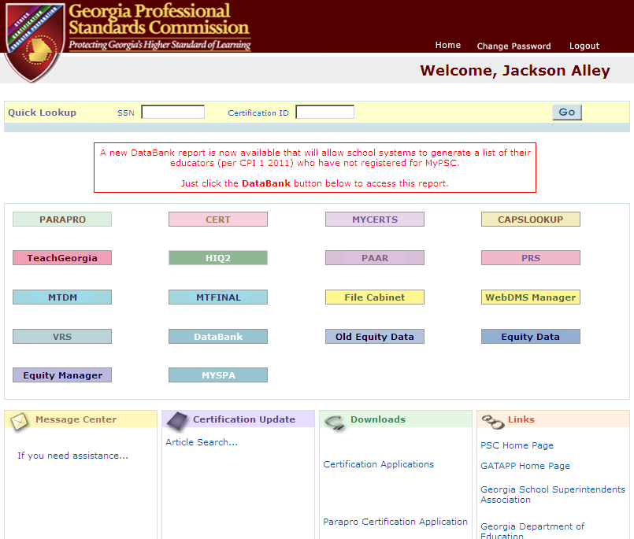
www.gapsc.org

Slide 9
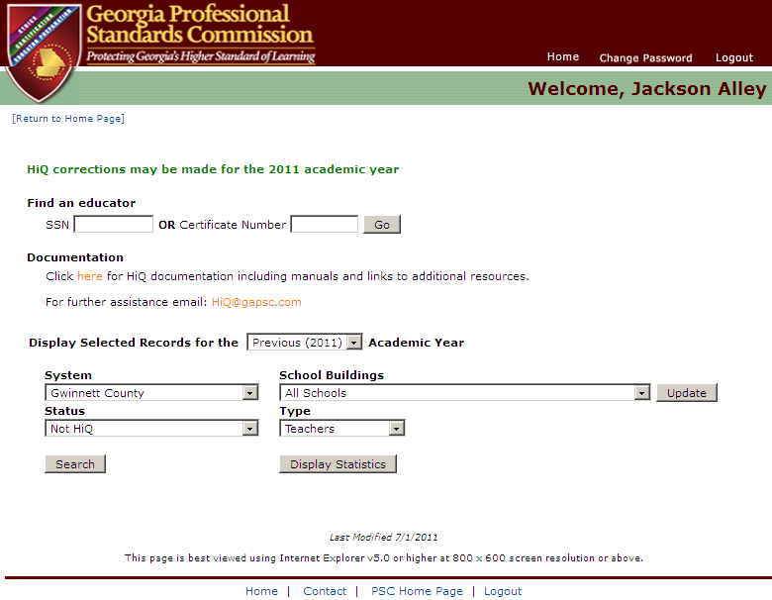
HiQ2 Main Page

Slide 10
School Buildings: Title I or Charter?

Slide 11
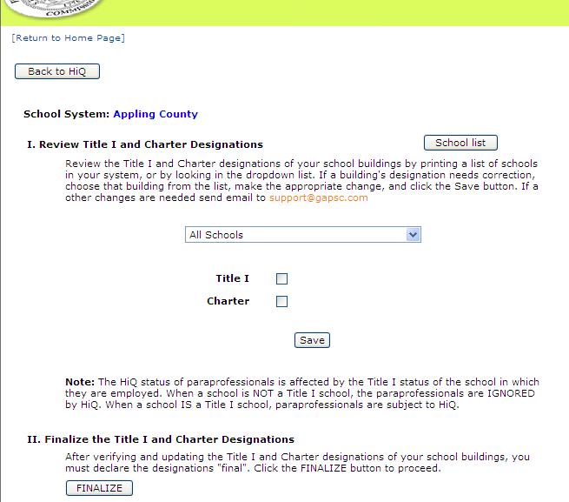
Title I or Charter: Edits
Check all of your buildings
Correct the Title I and/or Charter indicator
Click “School list” button to produce a printable list
Select a school from the drop-down list
Check Title I or Charter
Click the “Save” button

Slide 12
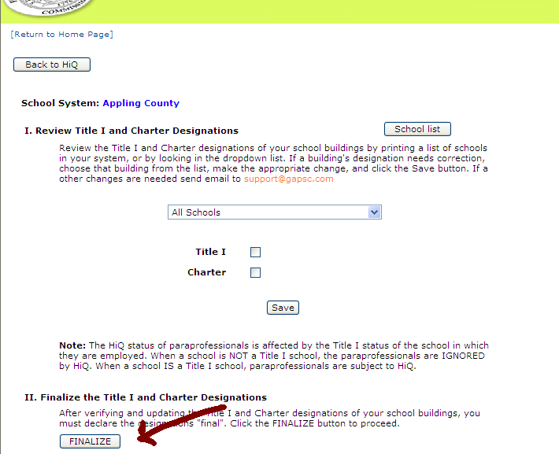
Title I or Charter: Edits
When all buildings are correctly designated, click the “Finalize” button

Slide 13
HiQ2 Main Page: By Status
List educators by HiQ status
Not HiQ
HiQ
Cannot Determine - check coding
HiQ not applicable
Corrected records

Slide 14
HiQ2 Main Page: By Type
List educators by “type”
Teachers
Paraprofessionals
Long Term Subs

Slide 15
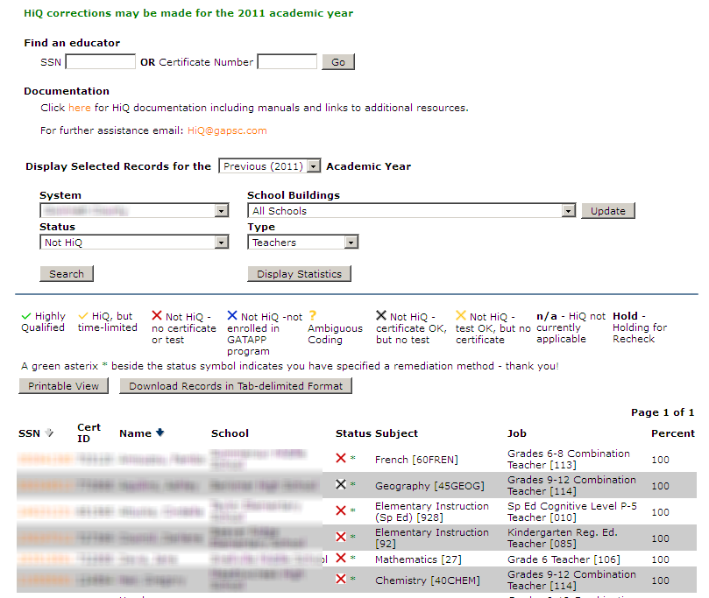
HiQ2 Main Page: List Records

Slide 16
HiQ2 Lists: Print or Download?
Printable View - prints ALL rows on All pages of the list
Download Records - generates a file suitable for opening in Excel

Slide 17
HiQ2 Main Page Detail
Locate an educator directly
Or
Add a new educator

Slide 18
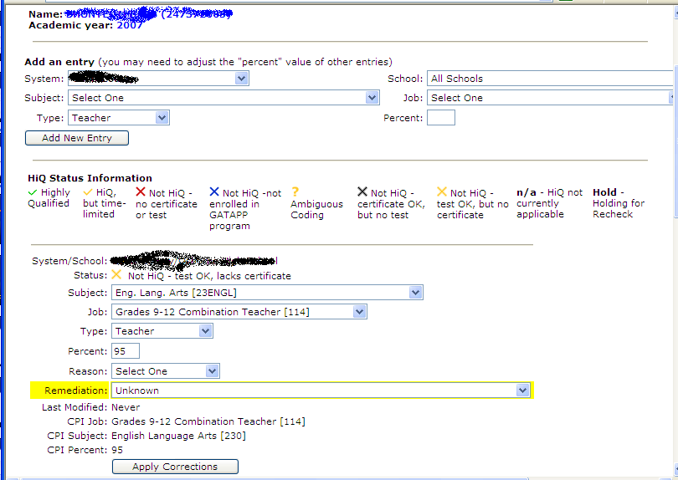
HiQ2 List: Click SSN to See Detail

Slide 19
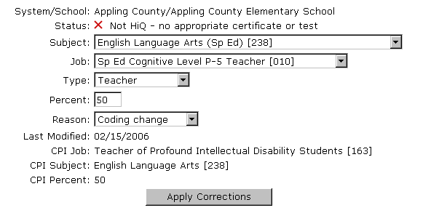
HiQ2 Detail Page: Assignments
HiQ Codes
CPI Codes

Slide 20
CPI and HiQ2 Subjects
CPI Subjects Titles | HiQ2 Subjects Codes
Elementary Education | Elementary Education (Special Education)
Social Studies | Government (Gifted)
English Lang Arts | Reading (Remedial)
Science | Physical Sciences – Chemistry

Slide 21
CPI and HiQ2 Jobs
CPI Job Codes | HiQ2 Job Codes
Gifted – 147 | Fifth Grade Teacher – 105 Subject Code Ending in “2”
ESOL Teacher – 144 | Middle Grades Teacher – 113 Subject: ESOL - 550
Teacher of Autistic Students – 167 | Elementary Teacher – 100 Subject Code: 928

Slide 22
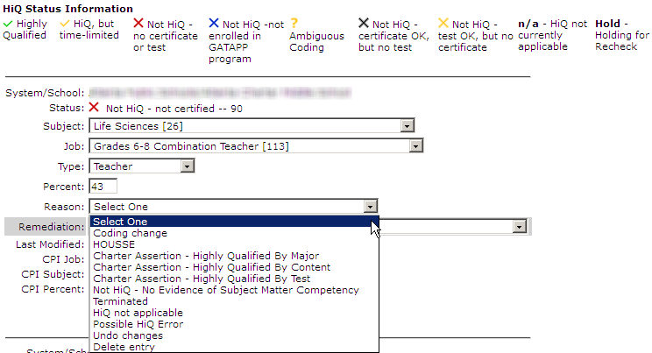
HiQ2 Reason Codes

Slide 23
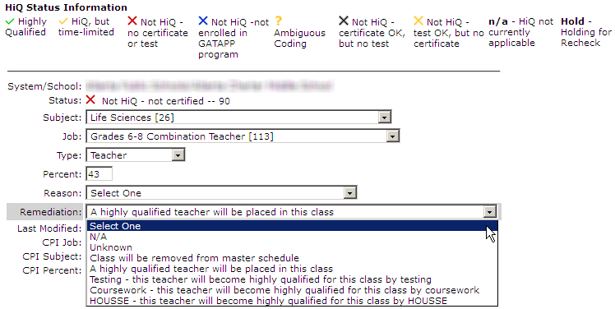
HiQ2 Remediation

Slide 24
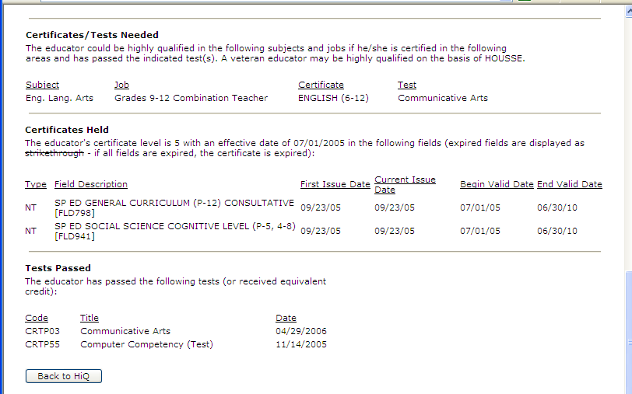
HiQ2 Detail: Bottom of Page

Slide 25
HiQ2 Detail Summary
Name (SSN)
HiQ status for each teaching assignment
If subject/job codes are ambiguous , a list of possible code “edits”
If not highly qualified, a list of certificates and tests needed to be considered highly qualified
Certificates currently held
Tests passed

Slide 26
HiQ2 Detail - Status
What are the possible values for the HiQ status?
“Highly qualified”
“Not highly qualified”
“Cannot determine”
“Not applicable”
Note: for final report, the percent highly qualified is...

Slide 27
Yearly HiQ Work Schedule
Sept – Work with your CPI Coordinator
January – Editing Begins in HiQ
- Check building designations (Title I)
- Correct any job assignment errors
- Recode ambiguous subject/job codes
June 30 – Editing Ends
August – Reports for Districts, GADOE, USDOE

Slide 28
Ethics of Data Reporting
Just a reminder to maintain the highest ethical standards when conducting all professional duties. It is against the law and considered a violation of professional ethics rules to falsify, misrepresent or omit information submitted to federal, state, local school districts and other governmental agencies.

Slide 29
Access To HiQ2
How do you get an account on www.gapsc.org?
CertHelp@gapsc.com

Slide 30
Thank You
Jackson Alley
Jackson.Alley@gapsc.com
Notes:
Thank you!

Slide 31
Contact Us
If you have questions about “coding”…

